Slide 1
Welcome
Automatic Vending Machine
(Hot & Cold Drinks)
Team Al-Sufi
Members: 1. Md. Afique Amin Zian(1631005)
2.Nasik Sami Khan(1638153)
3. Habib Faisal(1628223)
4. Istiak Khan( 1625203)

Slide 2
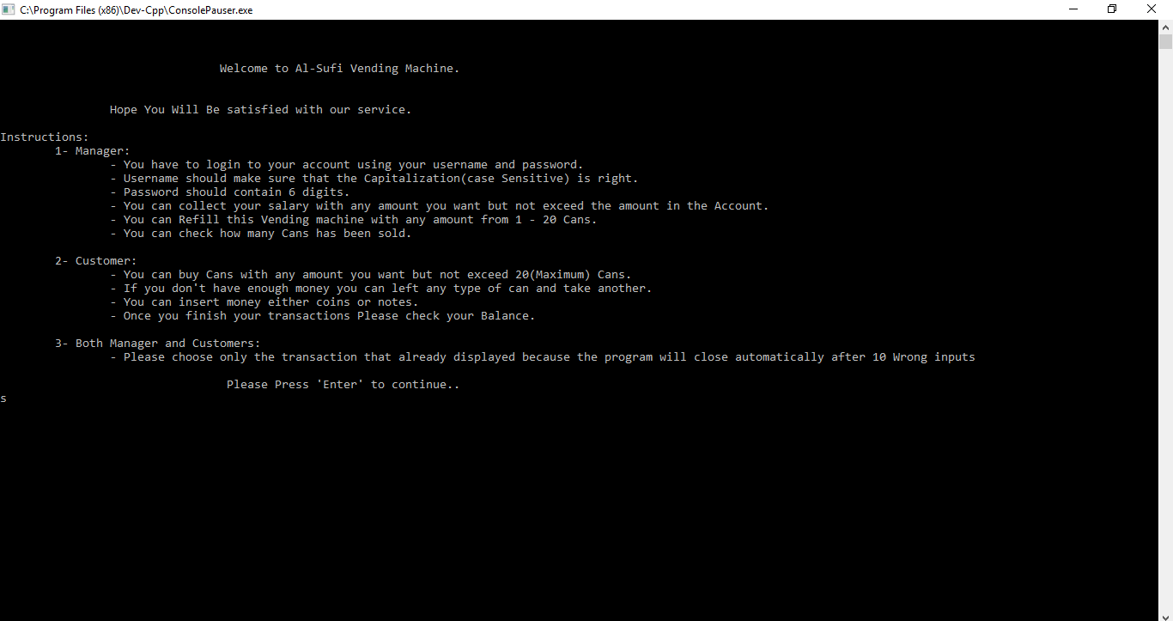
Topic we Covered
Input & Output
Control Structures
Functions
Arrays[1D]
Files
Pointer
Structure
External file

Slide 3
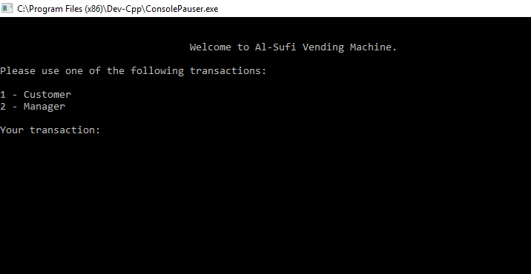
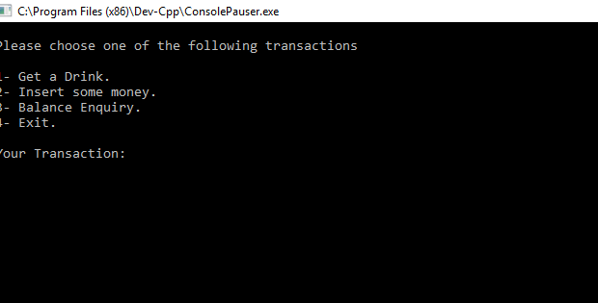
Dealing with two part in this program:
a)Customers
b)Managers
2. Customers can by their products
- Insert Money
- Choose drinks
-collect reciept

Slide 4
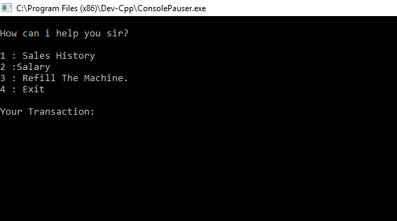
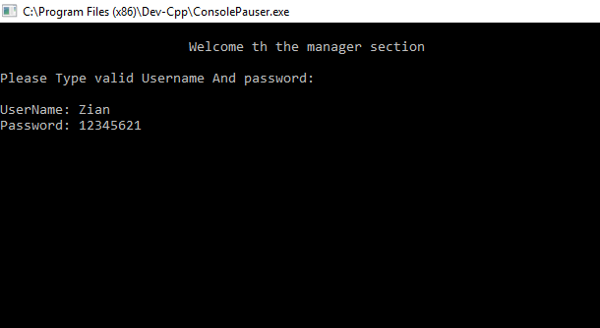
3. Managers of this machine
- check the purchase history
-get their salary
-refill the machine
But they need to login first with Valid
Username and Password.

Slide 5
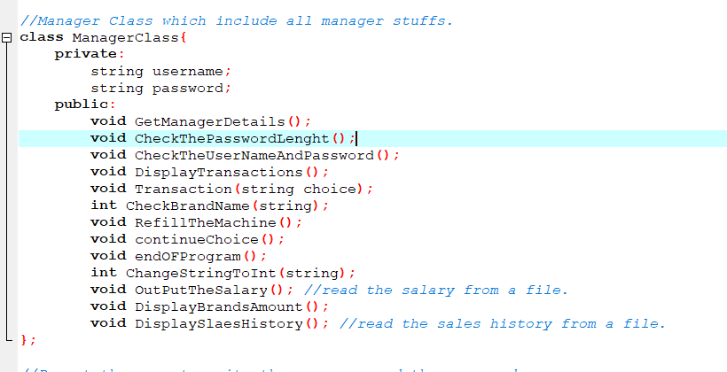
In This project:
a) Manager class Has 15 Functions: We also Use Class (Private and Public)

Slide 6
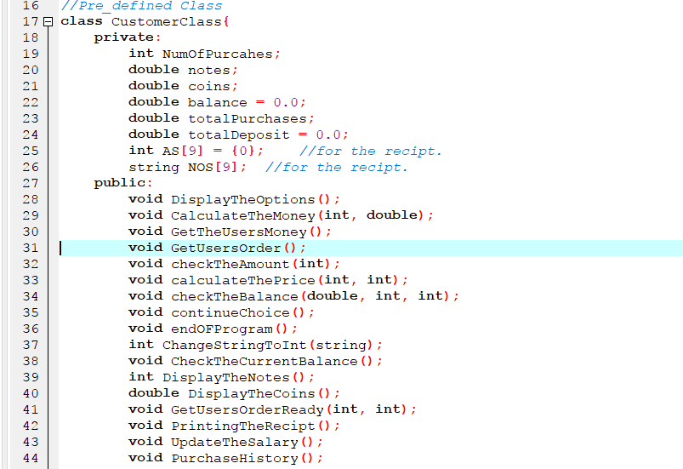
In This project:
Customer class has 21 Functions. With Public and Private class.

Slide 7
We also use different kinds of libraries for running the program successfully.
These are:
#include <windows.h>
#include <algorithm>
#include <iostream>
#include <iomanip>
#include <sstream>
#include <fstream>
#include <string>
#include <vector>
#include <cmath>
#include <set>

Slide 8
> The Input has to go through Some tests to make sure that it’s Valid
> The Program saves all purchase in a file, to give the user receipt at the end.
> You can check your salary , remaining items, purchase history through the file (Allowed to the managers)
>we provided comments to understand what happened in the code by reading the code wisely.

Slide 9
Robustness:
a) The program takes all inputs as string and it is able to change the datatype of the input by using specific function.
b) The program can not be crashed or goes infinite loop and display different message depends on the input.

Slide 10
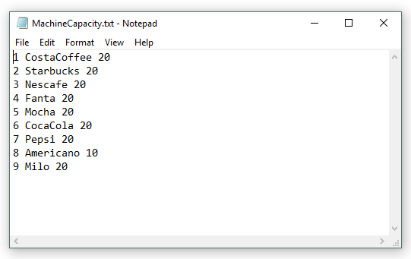
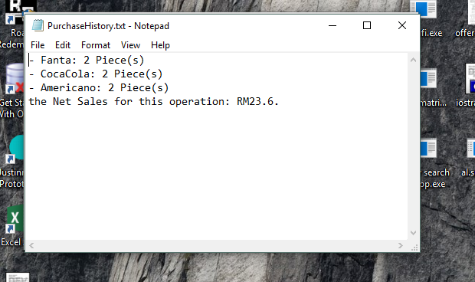
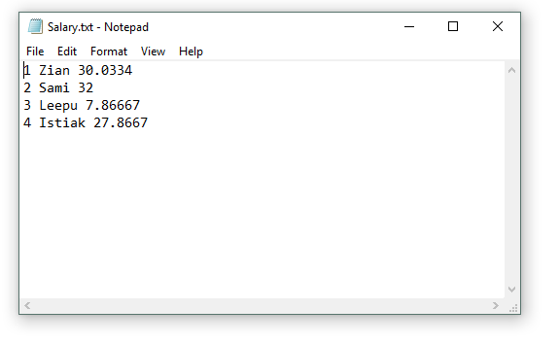
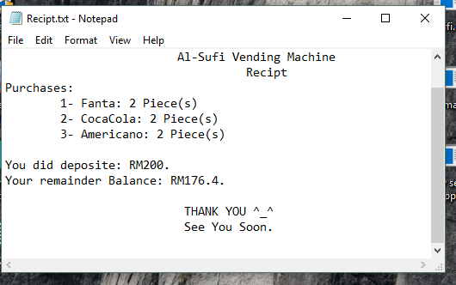
The receipt Files copy , salary copy and also the purchase history:

Slide 11
Thanks For Watching

